Slide 1

Therapy Outcome Measure
Measuring what’s important in
Assistive technology
14-5-08

Slide 2
Organ Level
Abnormality
Impairment/Body
Structure/Function
Body/Mind
Problems in body function or structure such as a significant deviation or loss

Slide 3
Person Level
Restriction
Disability/Activity
Abilities
Person
Difficulties an individual may have in the performance of activities.

Slide 4
Social Level
Disadvantage
Handicap/Participation
Circumstances
Society
Problems an individual may have in the manner or extent of involvement in life situations.

Slide 5
Happiness
Upset
Well-being/Distress
Feelings
Satisfaction
Emotional effect resulting in an upset, distress, or satisfaction with status

Slide 6
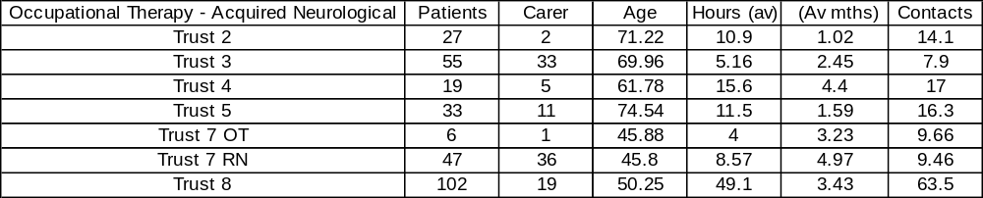
Therapy - Acquired Neurological

Slide 7
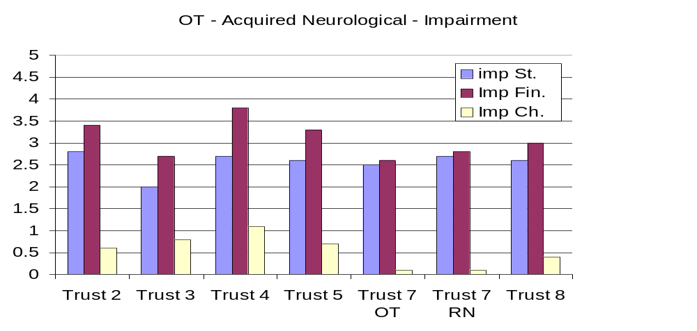
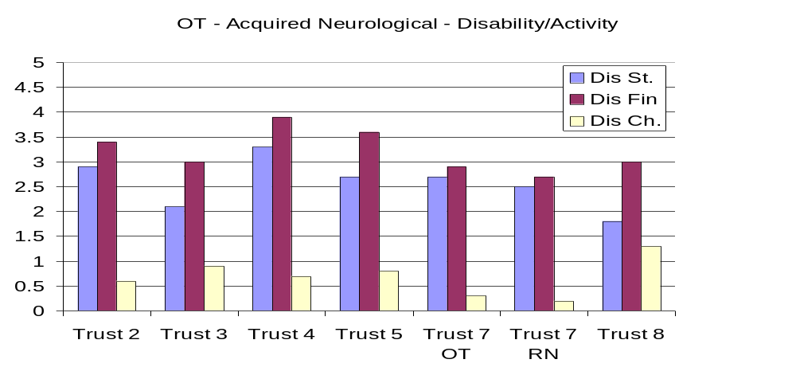
Occupational Therapy - Acquired Neurological

Slide 8
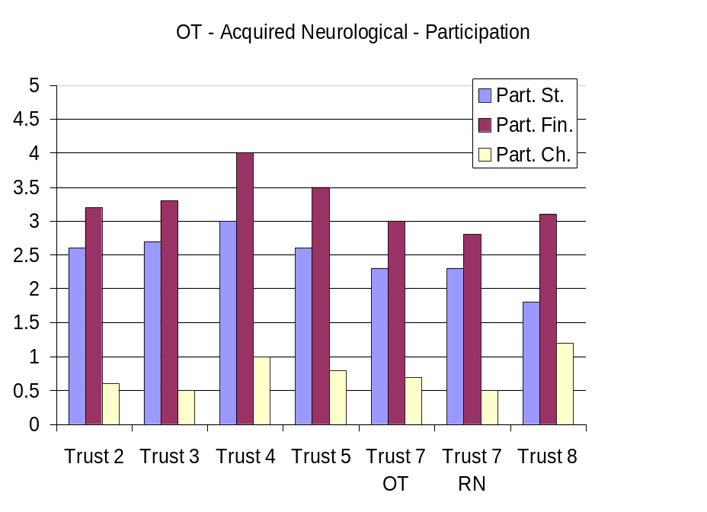
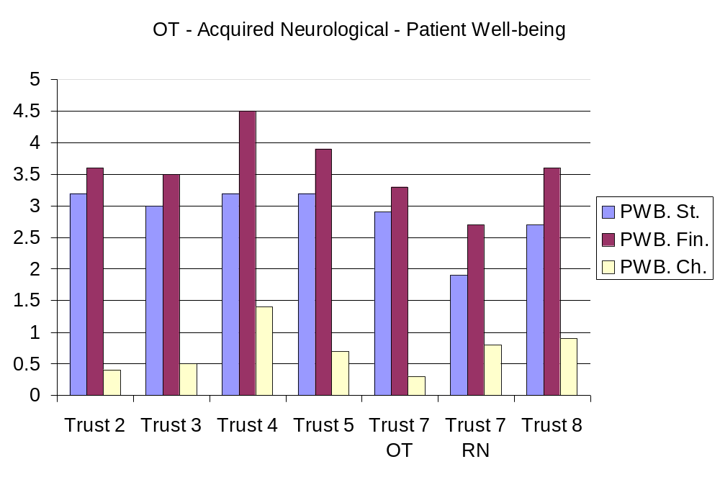
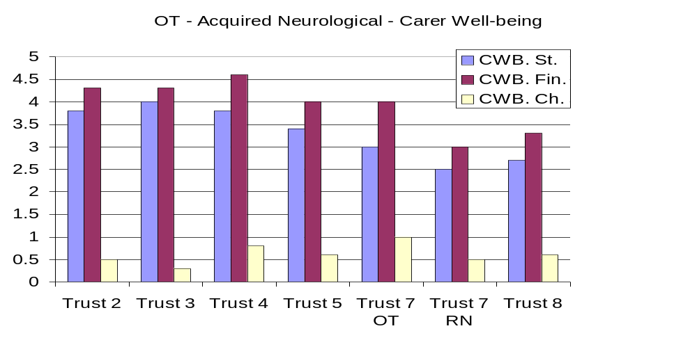
Occupational Therapy - Acquired Neurological

Slide 9
“the world is so fast that there are days when the person who says it can’t be done is interrupted by the person who is doing it”
Anon

